Slide 1
Proposal to Enhance Vehicle Safety for VRUs
VRU-Proxi-13-XX
4-6 February 2020 in Osaka, Japan
MLIT, Japan
VRU-Proxi-13-09

Slide 2
Contents
1. Background
2. Proposal (Our Priority)
3. Next Step

Slide 3
Traffic Accidents and Governmental Target
Fatalities
7th Gov. Safety Program
8th Gov. Safety Program
9th Gov. Safety Program
10th Gov. Safety Program
Accidents[m]
Injuries [m]
Fatalites
3,215
Injuries
460,715
Target
Fatalities
Below 2,500
Accidents
381,002
Injuries
Below 50 m
Vehicle Safety Target: ▲1,000 fatalities

Slide 4
Japan’s Vehicle Safety Policy regarding VRUs
Motor Vehicle Safety Policy (from FY2016 to FY2020) [June 24th 2016]
Safety Measures for Child and Elderly Person
Safety Measures for Pedestrian and Cyclist
To improve awareness of VRUs (pedestrian and cyclist) for drivers
e.g. AEBS, Advanced light system, Night-time pedestrian warning,
Driver’s visibility around vehicle
Emergency Measures for Elderly Drivers and Children
[June 18th 2019]
Countermeasures for car accidents involving elderly drivers and death of children
- Promotion of Safety Support Car
- Introduction of new driver’s license system limiting vehicle type

Slide 5
Injuries and Fatalities by Road User Type (2018)
Japan case
Pedestrians account for 35.6% (1,258) of total fatalities. (If includes cyclists, up to 48.4% (1,711).)
More than half of pedestrian fatalities are elderly persons (Age 65+).
Injuries (529,378)
Fatalities (3,532)
Others
0.1%
Others
0.3%
Pedestrian
9.5%
Cyclist
15.9%
Vehicle
33.9%
Pedestrian
35.6%
Vehicle
64.1%
Motorbike
10.3%
Motorbike
17.4%
Cyclist
12.8%
Source: 2018 Road traffic accident statics (National Police Agency)

Slide 6
Car(below 20km/h)-to-Pedestrian Injuries and Fatalities
Japan case
M1/N1 contributes to more than half of total fatalities and injuries among pedestrians, at low speed (below 20km/h).
Injuries
Fatalities
M3
(3.0%)
N3
(0.7%)
N3
(10.0%)
N2
(11.5%)
M3
(10.7%)
M2
（0.6%）
M1/N1
58.5%
M1/N1
84.2%
N2
（18.2%）
M2
（2.5%）
Source: Road traffic accident statics from 2014 to 2018 (5-year-accumulation) (ITARDA)
M1 and N1 M2 N2 M3 N3
Number of Injuries: 135,932 Number of fatalities：998

Slide 7
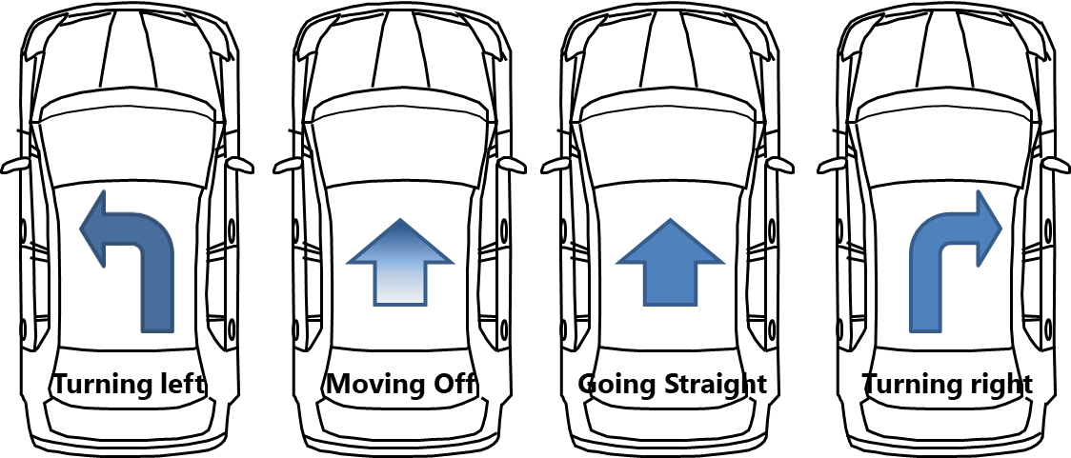
Car(M1/N1, below 20km/h)-to-Pedestrian Injuries and Fatalities
Japan case
CtoP Injury and Fatality Composition by Vehicle Motion
(M1/N1, Forward motion below 20km/h)
Injuries
Fatalities
10.4%
12.7%
29.5%
42.2%
14.3%
14.1%
17.3%
54.3%
Source: Road traffic accident statics from 2014 to 2018 (5-year-accumulation) (ITARDA)
Number of Injuries: 125,471 Number of fatalities：736 (*excluding other hitting points)

Slide 8
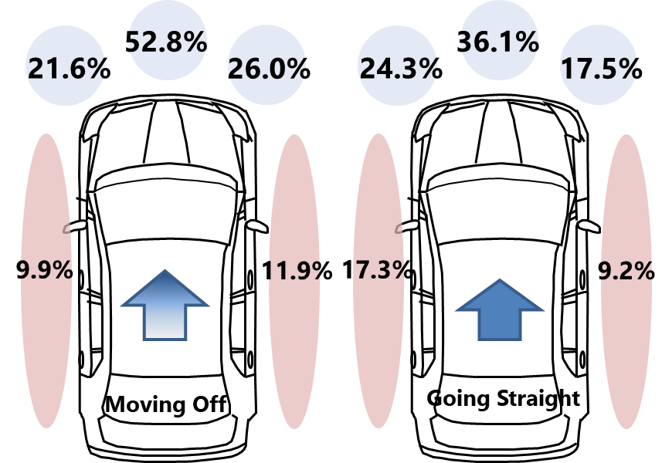
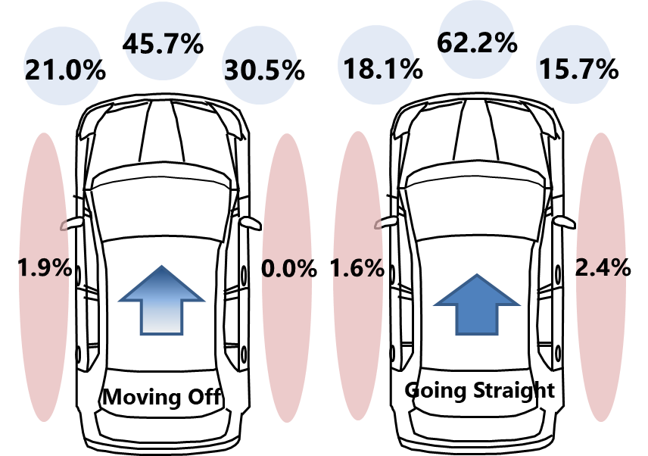
Car(M1/N1, below 20km/h)-to-Pedestrian Injuries and Fatalities
Japan case
CtoP Injury and Fatality Composition by Hitting Position
(M1/N1, Moving off/Going straight below 20km/h)
Injuries
Fatalities
Source: Road traffic accident statics from 2014 to 2018 (5-year-accumulation) (ITARDA)
Number of Injuries: 15,939 Number of fatalities：104 (*excluding other hitting points)

Slide 9
Car(M1/N1, below 20km/h)-to-Pedestrian Injuries and Fatalities
Japan case
CtoP Injury and Fatality Composition by Hitting Position
(M1/N1, Turning right below 20km/h)
Injuries
Fatalities
46.8%
62.8%
10.7%
33.1%
7.5%
29.0%
0.9%
8.5%
0.3%
0.5%
Turning right
Turning right
Source: Road traffic accident statics from 2014 to 2018 (5-year-accumulation) (ITARDA)
Number of Injuries: 59,493 Number of fatalities：400 (*excluding other hitting points)

Slide 10
Car(M1/N1, below 20km/h)-to-Pedestrian Injuries and Fatalities
Japan case
CtoP Injury and Fatality Composition by Hitting Position
(M1/N1, Turning left below 20km/h)
Injuries
Fatalities
39.3%
53.3%
31.5%
10.0%
31.4%
8.6%
17.4%
1.8%
6.7%
0.0%
Turning left
Turning left
Source: Road traffic accident statics from 2014 to 2018 (5-year-accumulation) (ITARDA)
Number of Injuries: 13,059 Number of fatalities：105 (*excluding other hitting points)

Slide 11
Proposal (Our Priority)
Scope: M1 and N1
Vehicle Motion: Moving off, Going straight (may include Turing left)
(*Maximum operational speed: 20km/h)
Detection Target: Pedestrians (may include cyclists)
Required Performance: Driver’s vision around the vehicle
(especially front and passenger-side
direction)
Advanced technology to provide
awareness for drivers

Slide 12
Next step
At this IWG, MLIT provided information of the necessity to enhance driver’s awareness of VRUs by focusing on M1/N1’s accidentology.
If CPs and other stakeholders kindly support it, we would like to proceed the discussion on drafting the forward motion of M1/N1.
Japan welcomes comments from CPs and stakeholders.

Slide 13
Thank you for your attention.

