Slide 1
Comments and answers for the JPN presentation
20th EVS-GTR IWG
January 2021

Slide 2
Comments for Japan Presentation
Comments
Answer
1
Concern of unexpected energy release from penetration hole
We tried to conduct the modified method using a test jig to prevent excess amount of exhausting gas from venting through penetration hole.
Additional
Info.1
In this case, comparison such as voltage drop, temperature and dT/dt between heating method and nail penetration method are used to judge.
In general, we need to explore how to judge "sufficient TR" for all the initiation methods and each cases.
2
How do you judge “sufficient TR”?
Additional
Info.2
It has been found that each method has advantages and disadvantages depending on the type of battery.
Regarding heating method, we are studying heater specifications and attached positions and matching various cells.
For nail method, we are also studying cells that do not trigger thermal runaway upon nail penetration.
We would like to explain with concrete data in next IWG.
If any CPs are interested in Japanese research, please contact us as we will hold a bilateral meeting.
3
What is appropriate heating time?
1300 seconds is too long?
4
Organize advantages and disadvantages on each initiation method.

Slide 3
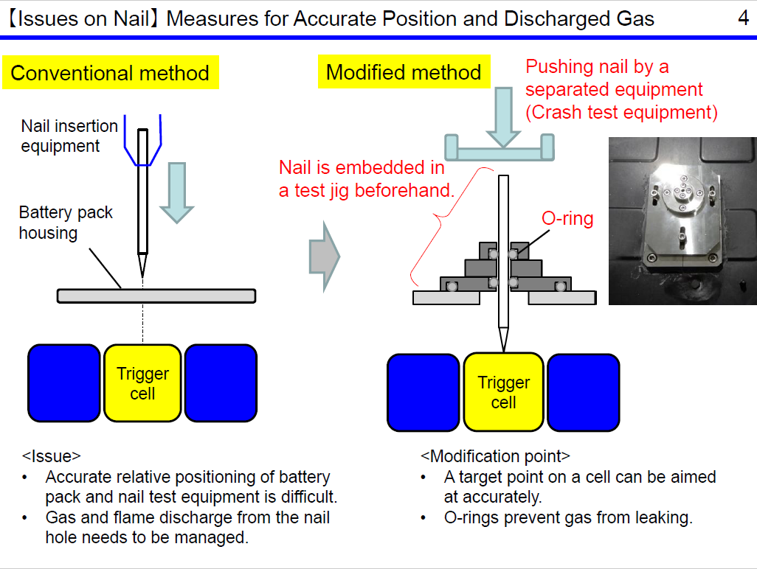
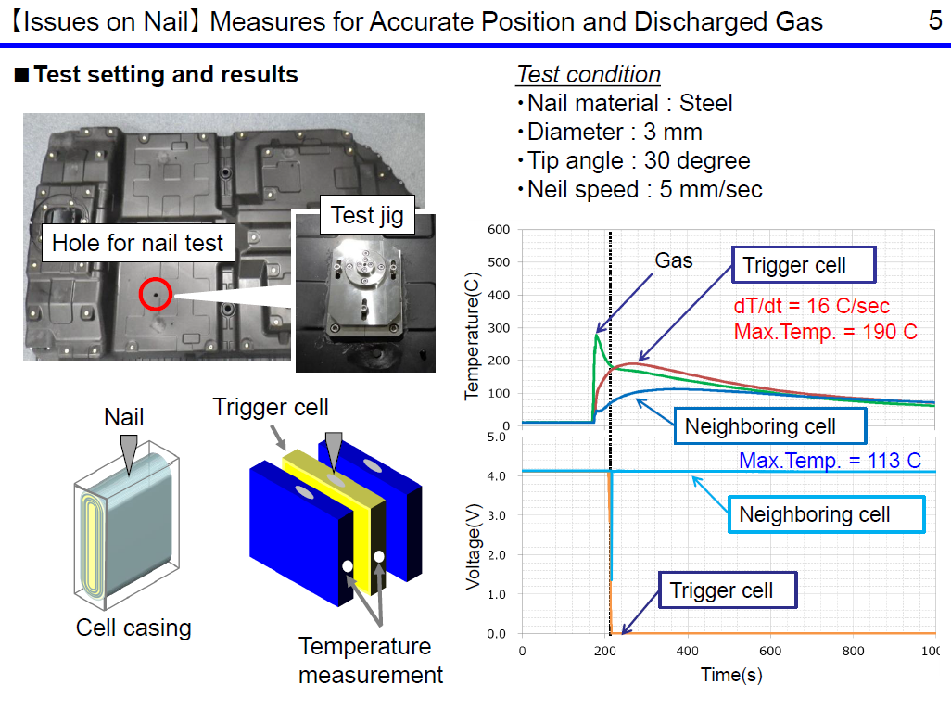
Concern of unexpected energy release from penetration hole
1
1
We tried to conduct the modified method using a test jig to take care to exhausting gas from penetration hole.
Japan Presentation on IWG#19

Slide 4
How do you judge “sufficient TR”?
1
2
We judged based on TR detection condition on GTR20 and visual check (smoke or fire) basically. But we think we need to study more this detection conditions.
Refer to GTR20 draft excerpt
23B.3.3. Detection of thermal runaway.
Thermal runaway can be detected by the following conditions:
(i) The measured voltage of the initiation cell drops;
(ii) The measured temperature exceeds [the maximum operating temperature defined by the manufacturer];
(iii) dT/dt ≥ [1 °C/s] of the measured temperature.
Thermal runaway can be judged when:
(a) Both (i) and (iii) are detected; or
(b) Both (ii) and (iii) are detected.
Test result table | Voltage(V)* *Reached voltage after initiation |  | (ⅱ) Temperature(℃) |  | (ⅲ) dT/dt
 | NP | Heating | NP | Heating | NP | Heating
Prismatic BEV | 0 | 0 | 300-400 | 600 | 34-53 | 48
Pouch PEV | 0 | 0 | 600 | 600 | 34 | 98
Prismatic HEV | 0 | 0 | 130 | 400 | 32 | 60

Slide 5
Thank you!

