Slide 1
Review and suggestion of vibration proposal
China

Slide 2
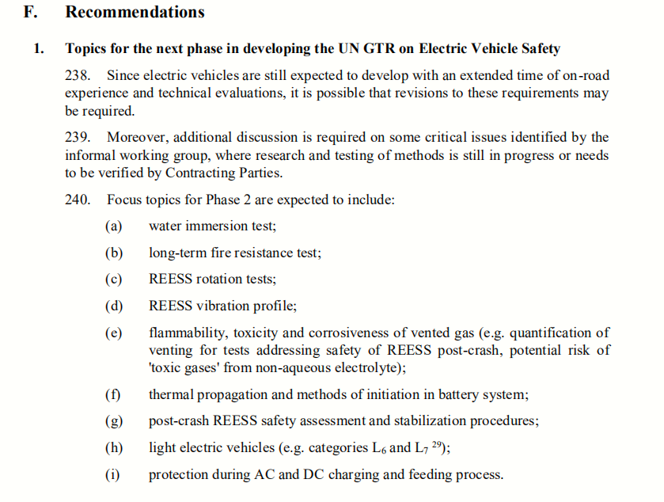
Review
ECE/TRANS/180/Add.20
P57
It is agreed that REESS vibration profile needs to be verified by CPs in phase 2.

Slide 3
Review
China: summed up the previous views and put forward vibration proposal again.
Japan: data and results of real vehicle test are introduced. Although Japan in principle agreed to the need for improving the profile, there are several issues to be discussed on the Chinese proposal.
OICA: four justiciations were put forward to prove that ISO6469-1 are more suitable than ECE R100.
Documents: evs18-e2vp-0300, evs18-e2vp-0200, evs18-e2vp-0100
China: proposed that GB is studying vibration test method based on real vehicle data
Document: evs1419-401
China: the reason for modifying the existing vibration method of GTR and the vibration proposal were put forward
Document: evs16-e4vp-0100
14th
15th
16th
17th
18th
19th
China: introduction of vibration concept, test data and derivation procedures
Documents: evs1544-401, evs1545-402
China: the shortcomings of GTR No. 20 are analyzed, and the necessity of modification of vibration method is explained by analyzing the case of actual sample.
Document: evs17-e4vp-0100
China: reintroduced the details of the formulation of China's proposal and comprehensively answered the questions of China Japan oica meeting.
ISO: introduced the development process of ISO6469-1 vibration, but there are still many unclear contents.
Documents: evs19-e3vp-0100, evs19-e3vp-0200, evs19-hact0410

Slide 4
Review
Proposals in EVS GTR 19th:
China's proposal in EVS GTR 19TH
OICA's proposal in EVS GTR 19TH
China noted that the current vibration method in GTR regulation is not reasonable and should be modified.
China noted that it’s possible to accept reasonable modification on the current proposal through GTR discussions
Document: EVS19-HACT0400 [CN]Final version of draft meeting minutes of CN-JP-OICA web-meeting
OICA suggested to use the same approach as ISO 6469-1:2019 to modify the current vibration method in GTR regulation, but allow OEM-specific test profiles and include the profile developed in China as an example for an OEM-specific profile.
Document: EVS19-HACT0400 [CN]Final version of draft meeting minutes of CN-JP-OICA web-meeting

Slide 5
China's position
China's view:
1) Vibration should be kept in GTR, because failures of mechanical connections and fixations caused by vibration may further cause short circuit of battery, which may cause more dangerous situations.
2) The vibration test method needs to be modified. The existing methods have problems in vibration form, vibration load, frequency range, etc., which have been introduced in detail in previous meetings.
Notes:
二阶段，

Slide 6
Thanks for your attention!

