Slide 1
SLR-36-01/Corr.1
Assumptions taken for glare line
• The intensity under cut-off for distances considered
(25 m…100 m) is high enough to cause glare
• Cut-off should be always under eye-height beyond 25 m from vehicle
• Minimum eye-height is 0.95 m
• Cut-off cannot be inclined higher than horizontal
FORMULA:
I= Δh/Lmin
I - cut-off inclination
Δh - headlamp optical axis height over minimum eye-height
Lmin - maximum distance beyond the vehicle where glare is accepted (25 m)

Slide 2
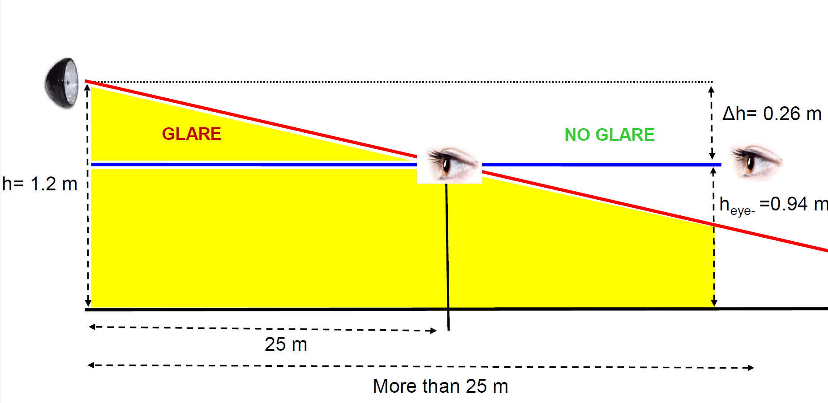

Slide 3
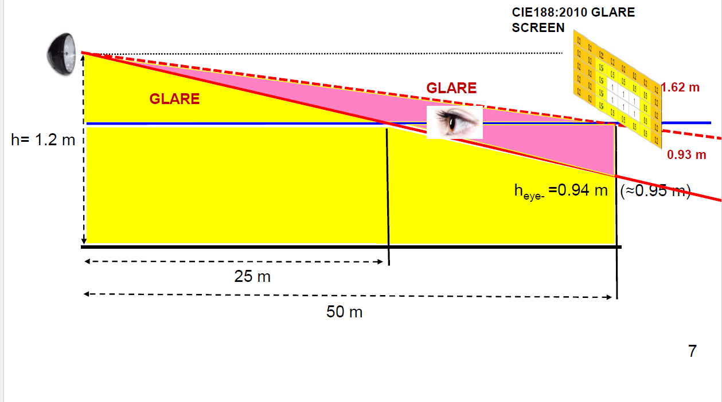

Slide 4
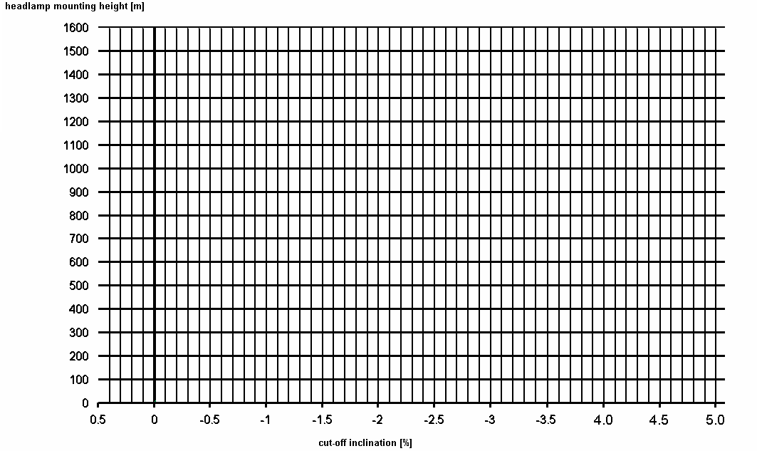
G
F
D
E
I
J
C
O
B
A
Point | Road illumination distance (with uncertainty) | glare distance (with uncertainty)
O | 100 m (50 m) | 0
B | 36 m (26 m) | 0
C | 50 m (39 m) | 0
D | 50 m (43 m) | 18 m (22 m)
G | 100 m (75 m) | 37 m (55 m)
I | 210 m (∞) | 20 m (∞)
Point | Road illumination distance (with uncertainty) | glare distance (with uncertainty)
O | 100 m (50 m) | 0 m
A | 42 m (30 m) | 0 m
E | 33 m (30 m) | 12 m (14 m)
F | 56 m (47 m) | 20 m (25 m)
J | 190 m (∞) | 0 m

