Slide 1


Document FRAV-04-15
Submitted by the experts from Germany
4th FRAV session (September 2020)
8 September 2020
Explanatory notes to the introduction of the document FRAV-03-03

Slide 2
From the Framework Document (FD):
Free of unreasonable risks:
This is a strategic decision, acknowledging the residual risk
  “When in the automated mode, the automated/autonomous vehicle should be free of unreasonable safety risks to the driver and other road users and ensure compliance with road traffic regulations.”,
  “This level of safety implies that an automated/autonomous vehicle shall not cause any non-tolerable risk [introduce unreasonable risks], meaning that automated/autonomous vehicle systems, while in automated mode, shall not cause any traffic accidents [incidents/events] resulting in [destruction of property,] injury or death that were reasonably foreseeable and preventable.”
To cause a risk:
a) cause an accident,
b) to not succeed to avoid a non-caused accident at least as good a human driver.
To cause an accident:
Cause an accident.

Slide 3
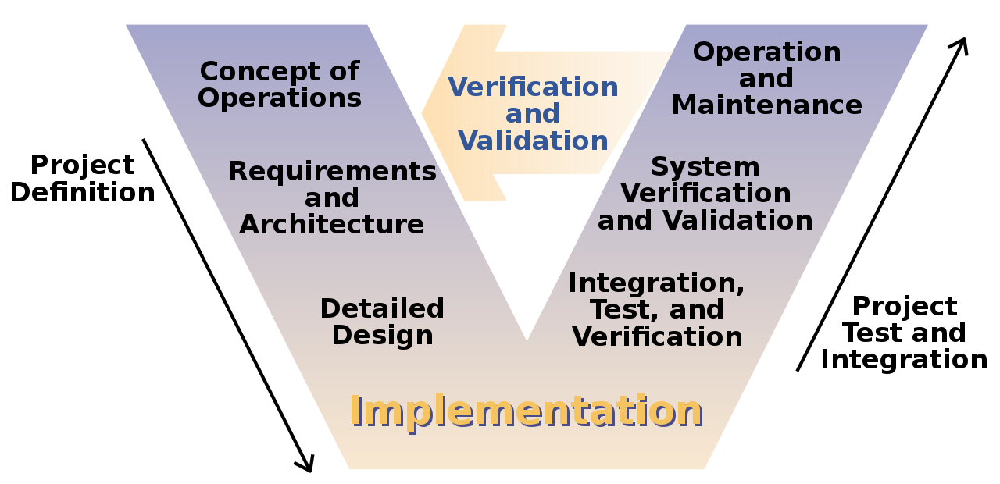
V-Model (Wikipedia):

Slide 4
V-Model
Requirements:
Does not cause unreasonable safety risks
Validation:
Did not cause unreasonable safety risks
(e.g. by balancing method)
Derived specifications
…not cause any traffic accidents [incidents/events] resulting in [destruction of property,] injury or death that were reasonably foreseeable and preventable.
More specs?
Process of Derivation of Specifications
intransparent?
Derived specifications
Specification:
Avoid the scenario x and
mitigate an accident in the scenario y
Verification:
Test scenario x and verify avoidance
Test scenario y and verify mitigation

Slide 5
„Reasonably foreseeable and preventable“
Foreseeable by whom?
  Expert Driver
  Computer with sensors
  Programmer of ADS
  Neural Network
Preventable through what?
  Expert Driver-like control system
  Fast brake actuator
  Fast steering system
RFaP needs further specification
and interpretation!

Slide 6
Conclusions and Proposal from FRAV-03-03
Framework Document defines top-level requirements
Specifications need to be derived
Some kind of „product development process“ (→ V-Model)
Define RFaP on a technical basis
Process proposal: Agree on Specifications top-down!
  As opposed to collecting requirements where the derivation is unclear
Technical proposal (as an example):
  Physical limitations (DE‘s preference)
  (Safety Envelope is a special form of physical limitations)
  Expert driver model

