Slide 1
EPPR
Proposal on CAT monitoring
IMMA
Background
Result of Survey findings
Proposal

Slide 2
Background
Result of Survey findings
Proposal

Slide 3

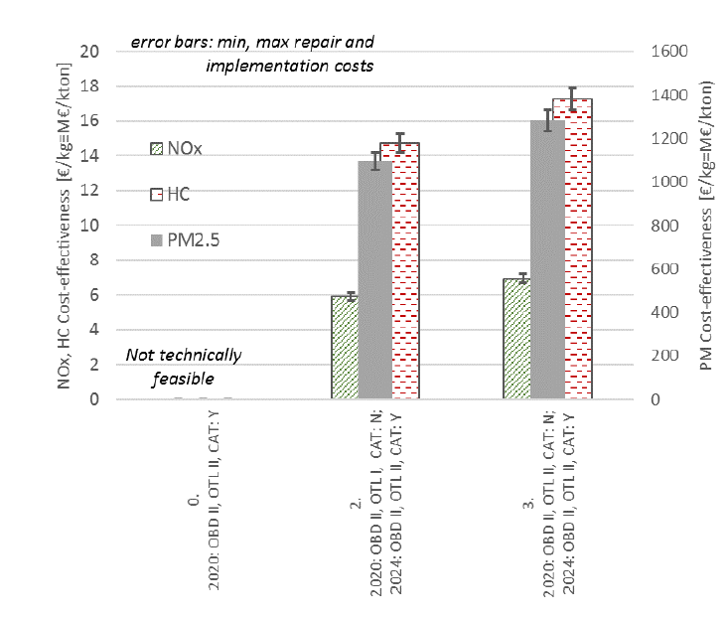
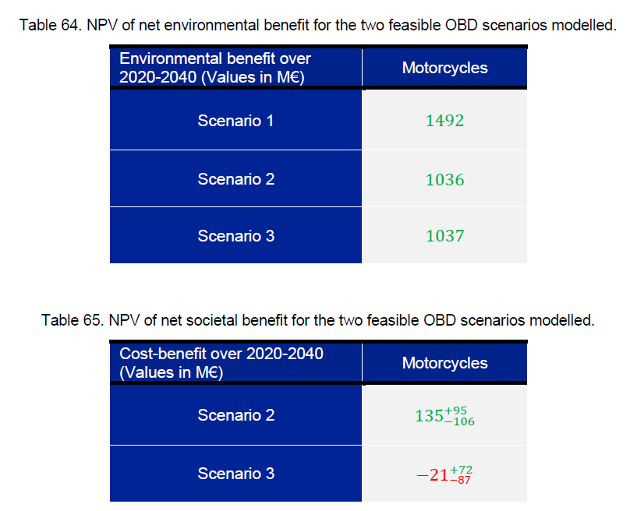
Justification of EC for the implementation of CAT monitoring on Euro5
In the Euro 5-study, OBD 2 was verified by cost effectiveness, and it was decided to be implemented including catalyst monitoring from 2024.
EMISIA (the technical consultant appointed by EC) performed this verification.

Slide 4

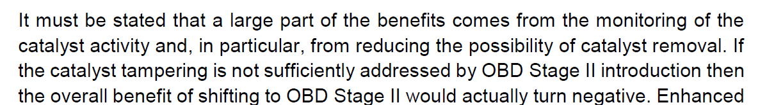
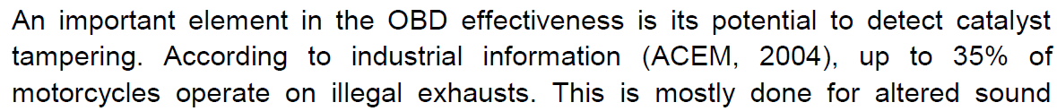
Benefit of CAT monitoring and assumption adopted for verification
According to the study results, degradation of CAT was not the problem.
The benefit of catalyst monitoring comes mostly from the prevention of CAT tampering and it depends on the actual rate of muffler tampering in the market.
If the tampering rate is low, overall cost effectiveness will actually be reduced.
In Euro5 study, EMISIA evaluated benefit of CAT monitoring under assumption that 40% of total fleets are tampered and if CAT monitoring is applied, tampering rate becomes 0%.
If the situation of CAT tampering is different, cost effectiveness will also differ.
The tampering rate in India, Japan and China may not be the same as EU.

Slide 5
Background
Result of Survey findings
Proposal
Survey and calculation of CBA was conducted by EMISIA

Slide 6
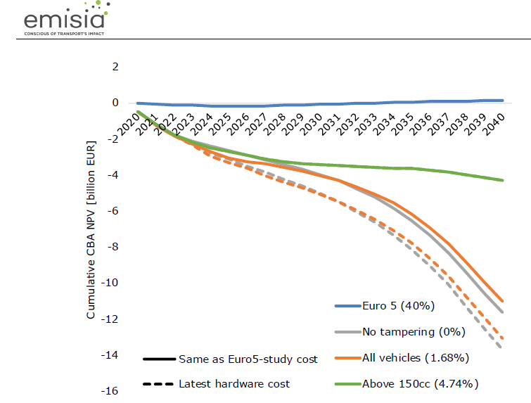
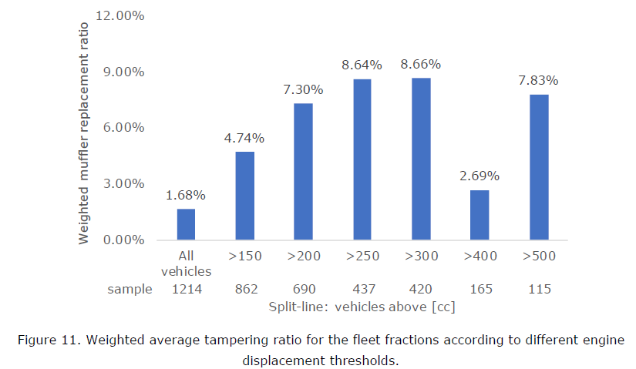
Result of survey on tampering rate and CBA in India
【India】
Tampering rate: 1.68%
Net Societal damage:12 to 14 Billion Euro (benefit in EU: 0.135 Billion Euro)

Slide 7
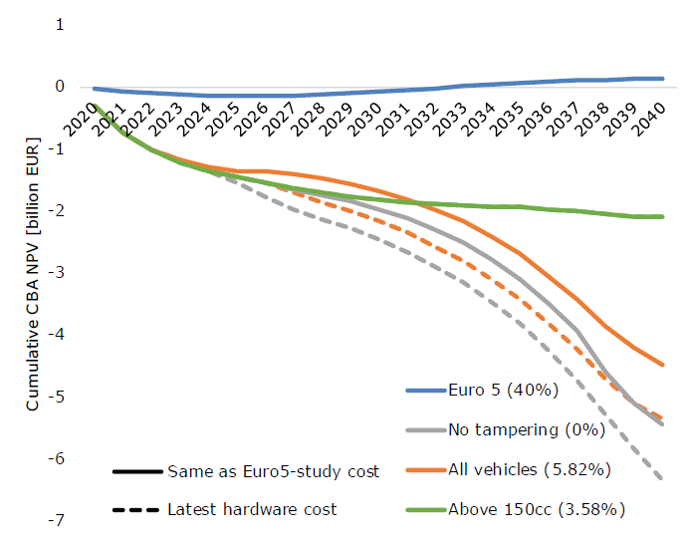
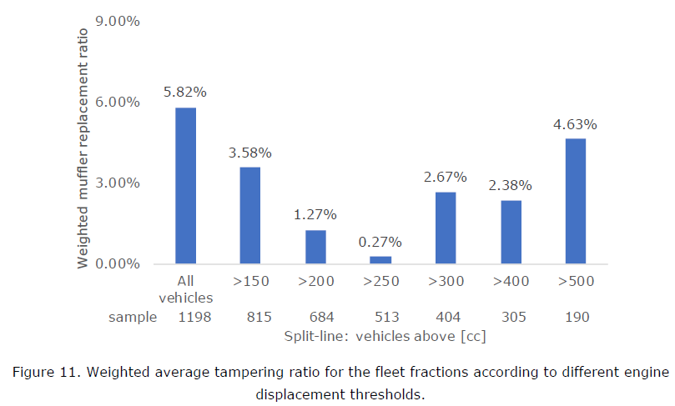
Result of survey on tampering rate and CBA in China
【China】
Tampering rate: 5.82%
Net Societal damage: 4.5 to 5.5 Billion Euro (benefit in EU: 0.135 Billion Euro)

Slide 8
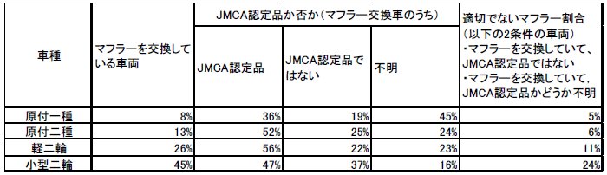
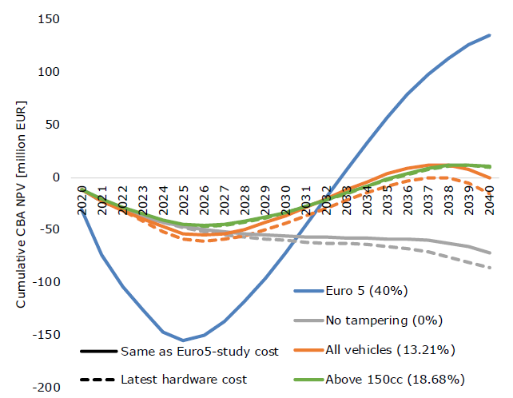
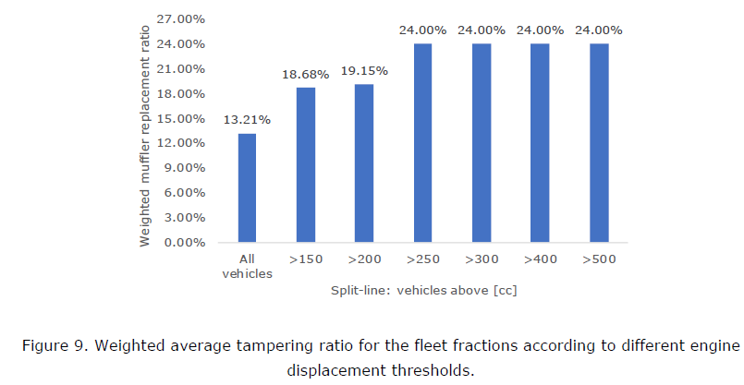
Result of survey on tampering rate and CBA in Japan
【Japan】
Tampering rate: 13.21%
Net Societal damage:0 to 10 million Euro (Benefit in EU 0.135 Billion Euro)
Result of JARI survey 2016

Slide 9
Summary of survey results on tampering rate and CBA
CAT monitoring is not effective in India, China, and Japan
Especially in India and China, result of CBA shows huge economical damage to the society.
CAT monitoring does not make sense for India, China, and Japan.
From the Study performed by IMMA, benefit of catalyst monitoring in Japan, China, and India turned out to be negative.
Based on this result, IMMA suggests each CP to re-consider the necessity of this requirement for their local regulation,
and to review the text of GTR accordingly.
Since CPs require time to consider, IMMA proposes to take some time before concluding GTR18 amend.

Slide 10
Background
Result of Survey findings
Proposal

Slide 11
Issue / Proposal
Issue: OBD2 GTR is planned to be submitted to GRPE in March,
but careful discussion is necessary for CAT monitoring.
 | JAN | FEB | MAR | APR | MAY | JUN | JUL | AUG | SEP | OCT | NOV | DEC | JAN
EPPR
Current schedule
★INFORMAL DOCUMENT
★FORMAL DOCUMENT
★GRPE
★WP29
★EPPR
★EPPR
★EPPR
★EPPR
★EPPR
Postponed
schedule
★FORMAL DOCUMENT
★GRPE
★WP29
JUN
Proposal: IMMA proposes to postpone the submission of GTR formal document
and to discuss this issue at next EPPR in June.

Slide 12
Thank you

